Slide 1
Developing Digital Educational Materials Using AI Tools
METU Distance Education Application and Research Center

Slide 2
Outline
Creating Course Content
Which AI tools can be used to search for and create course content?
Creating Media
Which AI tools can be used for creating presentation slides?
Which AI tools can be used for creating images related to course content?
Which AI tools can be used for creating animations and videos?
Creating a Complete Course Module Using the Created Content and Visuals

Slide 3
Creating Course Content
Sample Artificial Intelligence (AI) Tools for Creating Course Content:
General Use
ChatGPT (chat.openai.com)
Google Bard (bard.google.com)
Educational Use
Almanack (app.almanack.ai)
EduAide (eduaide.ai/app/generator)

Slide 4
Creating Course Content
ChatGPT (chat.openai.com)
ChatGPT is an artificial intelligence model developed by OpenAI.
Answers text-based questions and perform text-based tasks.
Generate and understand text based on a wide knowledge base.
Generate text-based interactions, text generation, translation, summarization, and question-answering.
Not possible to gather real-time information from the web using the free version of ChatGPT (Version 3.5). It is possible with ChatGPT Version 4 that can be used with paid subscription.

Slide 5
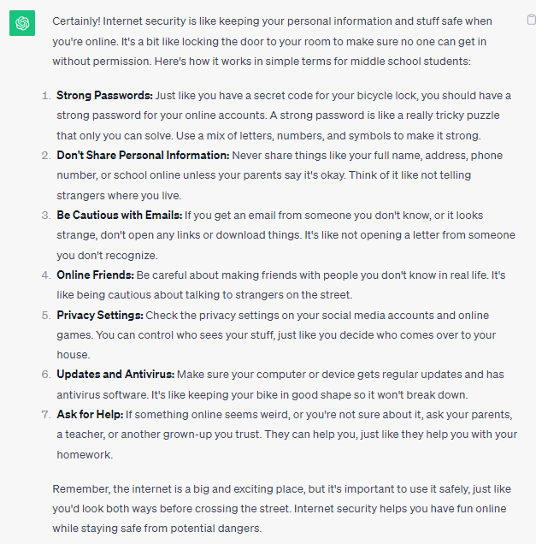
Creating Course Content
ChatGPT
Sample ChatGPT prompt:
Explain the basics of Internet Security in a way that is easy for middle school students to understand.

Slide 6
Creating Course Content
Google Bard (bard.google.com)
Google Bard is a large language model developed by Google AI and was released in the United Kingdom for testing on March 21, 2023.
Bard possesses various capabilities, including text generation, translation between languages, creative content writing, and informative question answering.
Google Bard can be used to obtain up-to-date information from the web free of charge.

Slide 7
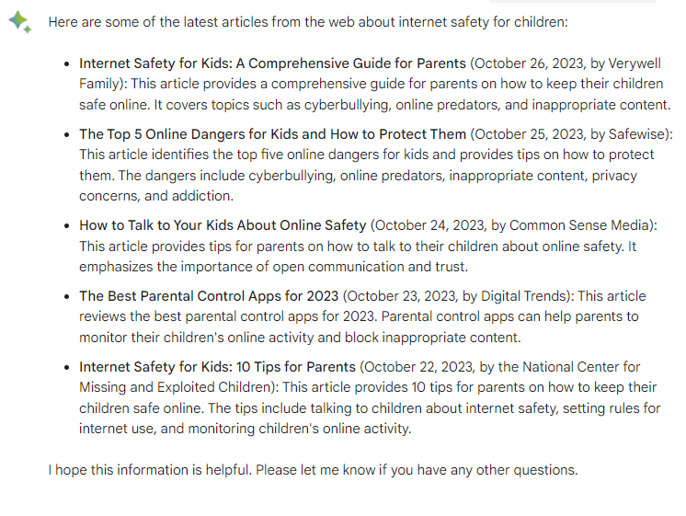
Creating Course Content
Google Bard
Sample Bard prompt:
Provide me the latest articles from the web about Internet Safety for Children.

Slide 8
Creating Course Content
The Use of ChatGPT and Google Bard in Education
Content Creation: lesson plans, explanations of complex topics, sample questions and answers, tests on various subjects.
Research Assistance: conducting research and gathering data for educational materials.
Correction and Editing: grammar, spelling, and style, ensuring that materials are of high quality.
Idea Generation: ideas for creative teaching strategies or project ideas
Customized Materials: using learning objectives or keywords to generate content tailored to specific needs.

Slide 9
Creating Course Content
Almanack - (app.almanack.ai)
Almanack is a smart course material generator and lesson planner for educators.
You can easily create lesson plans and course materials with Almanack’s intuitive interface and AI recommendations.
You can create complete presentation slides (slide decks) with information and pictures.
You can create learning objectives for your course.
You can export lessons, lesson plans and generated presentations to Google docs or your computer.

Slide 10
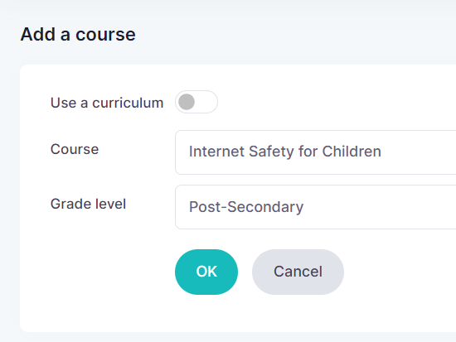
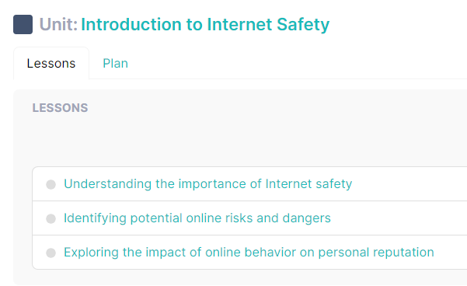
Creating Course Content
Almanack

Slide 11
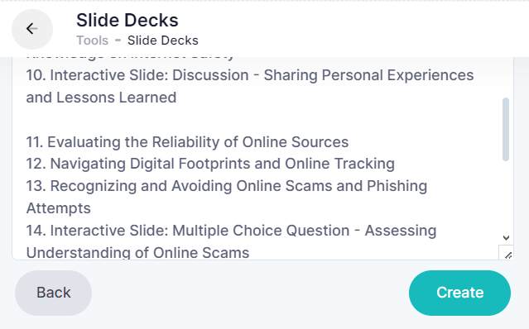
Creating Course Content
Almanack

Slide 12
Creating Course Content
Eduaide - (eduaide.ai/app/generator)
Eduaide offers AI-assisted lesson development.
You can input the grade level, topic, and keywords, and the tool generates a lesson plan with objectives, teaching strategies, activities, assessment ideas, and closure questions.
The generated lesson plan can be personalized and modified to align with their students' needs. Eduaide also offers features like content generators, question generators, communication tools, productivity, and community tools.

Slide 13
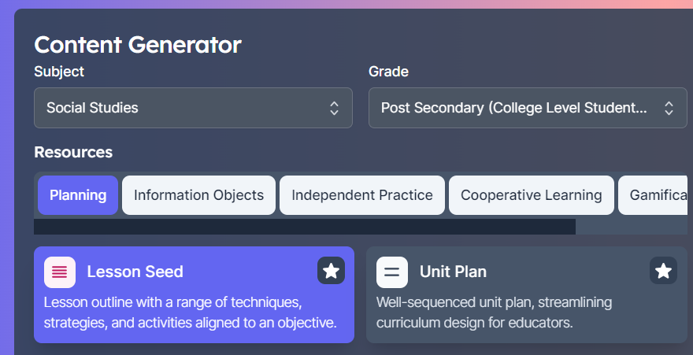
Creating Course Content
Eduaide

Slide 14
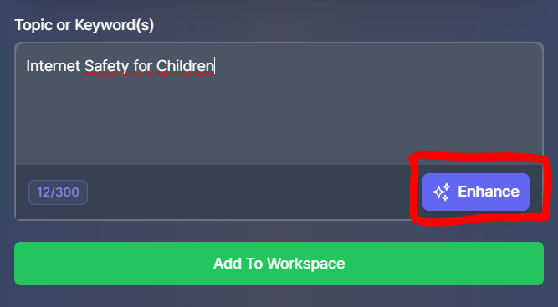
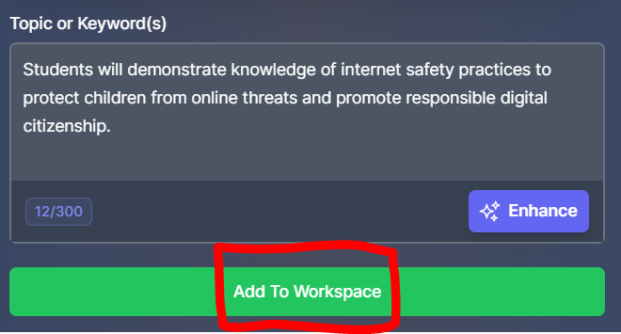
Creating Course Content
Eduaide

Slide 15
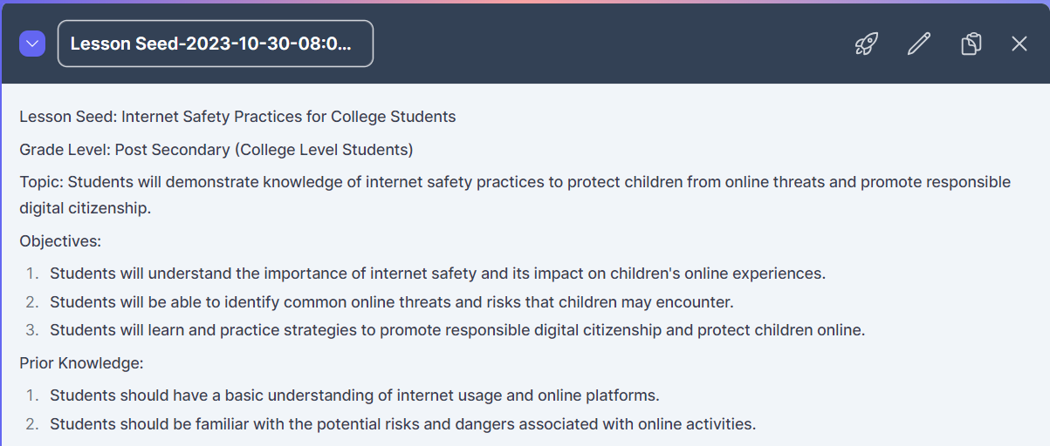
Creating Course Content
Eduaide

Slide 16
Creating Course Content
Considerations When Using Artificial Intelligence Tools to Create Educational Content:
AI Model Limitations and Mistakes
Importance of Model Updates
Contextualization of AI Data
Human Oversight for Information
Ethical Considerations in AI Education
Notes:
Artificial intelligence models operate within specific limits, and it's important to remember that they can make mistakes. Developing awareness about the model's uncertainties is crucial.
The more up-to-date and retrained the artificial intelligence model is, the more reliable its results can be. Models that become outdated may not adapt well to new data and developments.
Artificial intelligence tools contextualize data within a specific framework. Results may be inappropriate when data is taken out of context.
It is important for information generated by artificial intelligence to undergo human oversight to ensure its reliability.
Additionally, ethical considerations related to the use of AI in education should be taken into account. Educators should be aware of the source of information and ensure that content generated by AI is ethically and pedagogically suitable for their students.

Slide 17
Creating Course Content
Other AI tools for Content Generation
Tutoria (https://www.tutorai.me): TutorAI is an AI-driven platform that allows users to quickly and easily learn about any topic of their choosing.
Mini Course Generator (https://minicoursegenerator.com): Mini Course Generator is a neat tool that makes it easy to create and publish short courses.
Coursebox (https://www.coursebox.ai): Coursebox is an AI Course Creator that makes it easy and fast to build your online course.
ChatPDF (https://www.chatpdf.com): ChatPDF is a free, online tool that can assist you with any PDF-reading task. By uploading your PDF file to the platform, you’ll receive an AI-generated summary and potential questions you could ask, to help you learn more from your document.

Slide 18
Creating Presentations with AI
+
PlusAI

Slide 19
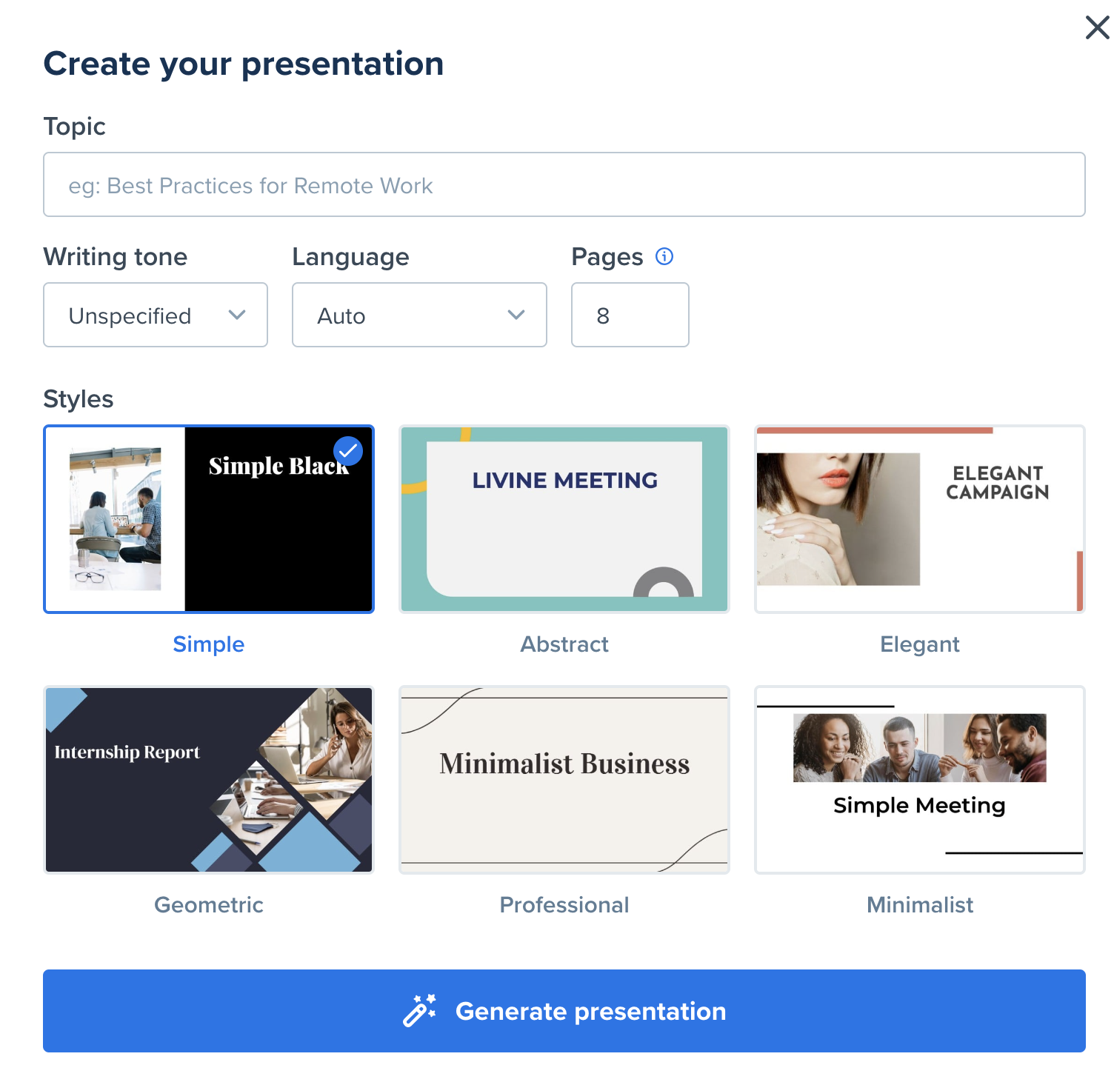
Creating Presentations with AI
Choose a topic
Specify options
Select a style
Generate the presentation
https://wepik.com/ai-presentations

Slide 20
Creating Presentations with AI
Create a new blank presentation
Extensions - Get an extension
Extensions
+
PlusAI

Slide 21
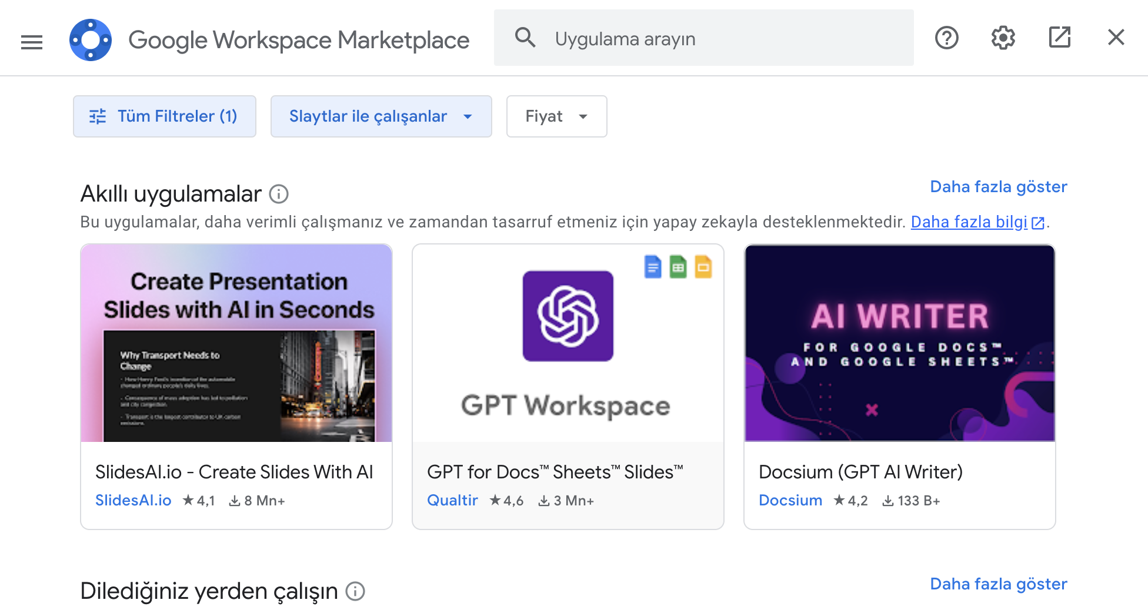
Creating Presentations with AI
Install SlidesAI.io

Slide 22
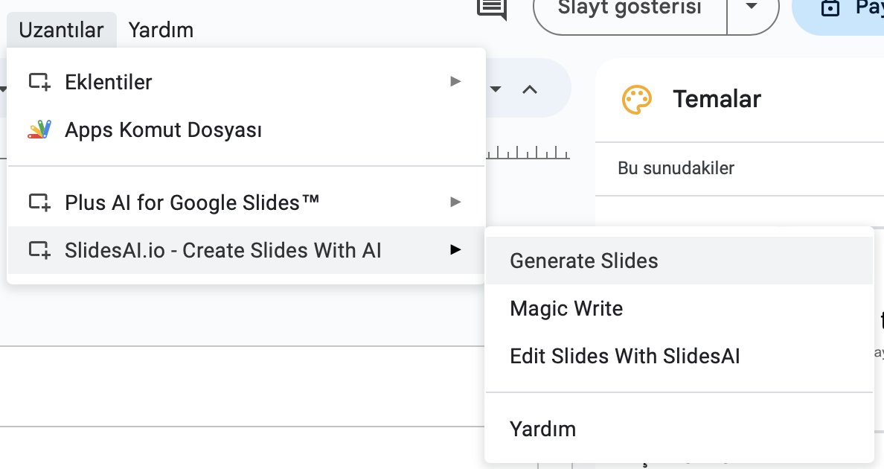
Creating Presentations with AI
Click Generate Slides

Slide 23
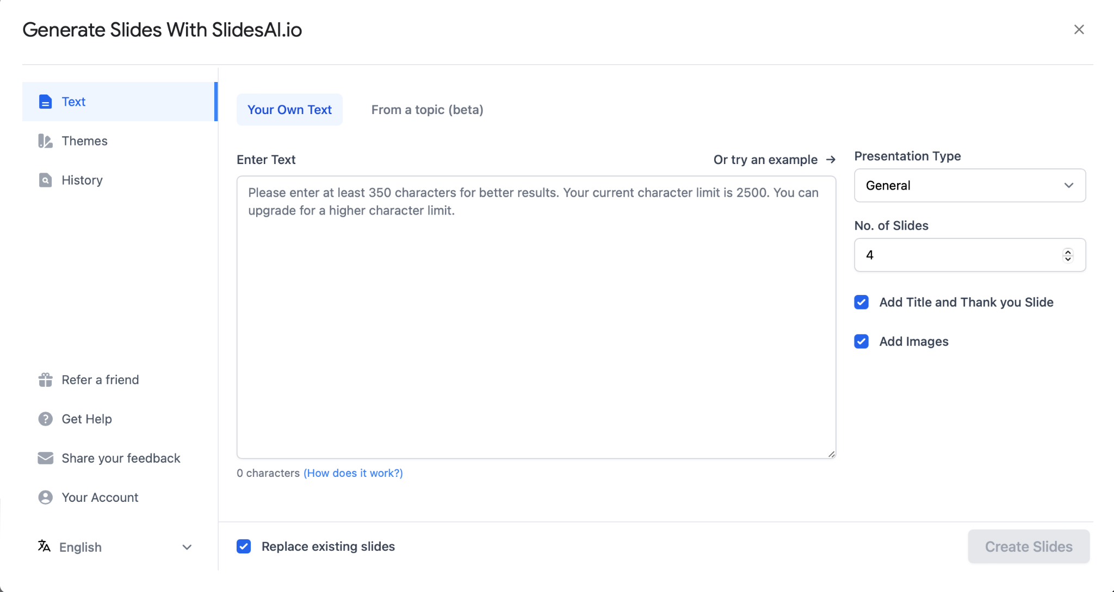
Creating Presentations with AI
Adjust Settings
From our own text or just writing a topic

Slide 24
Creating Presentations with AI
Magic Write includes various AI tools

Slide 25
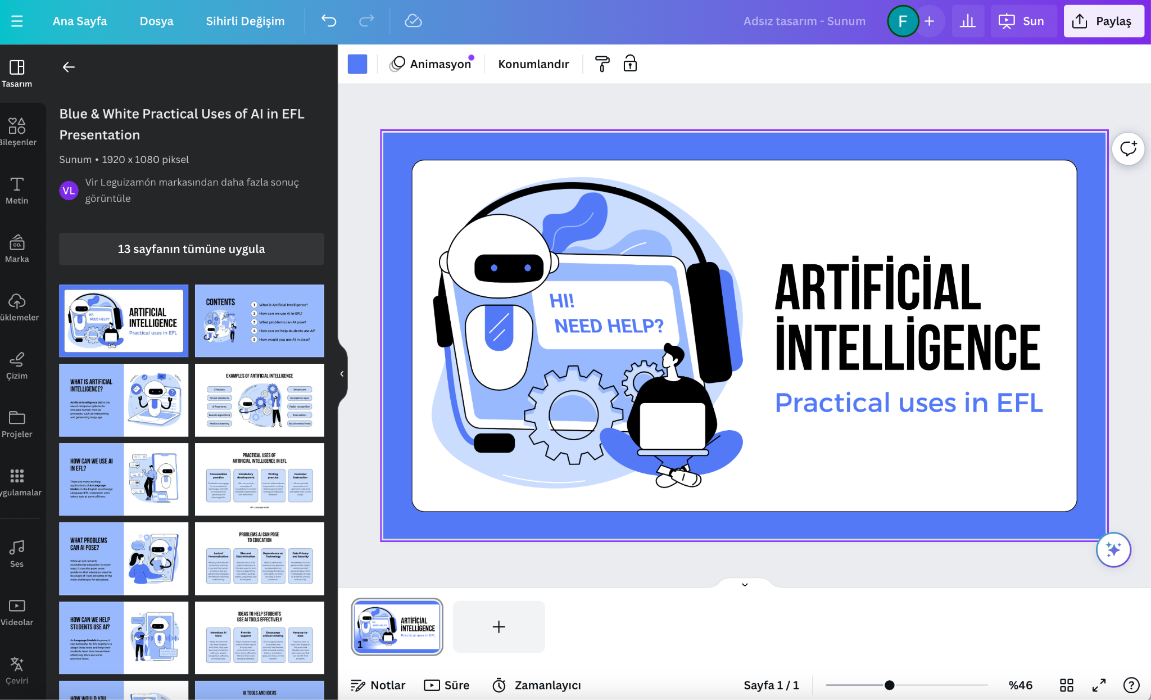
Creating Visuals, Audio and Video with AI
Canva - www.canva.com
Online design tool
Presentation, Video, Infographic, Social Media/Blog images, Posters, Videos, Educational Materials
Easy to use
There is a version for education
There are many templates available
AI powered apps
https://www.canva.com/education/teaching-resources/

Slide 26
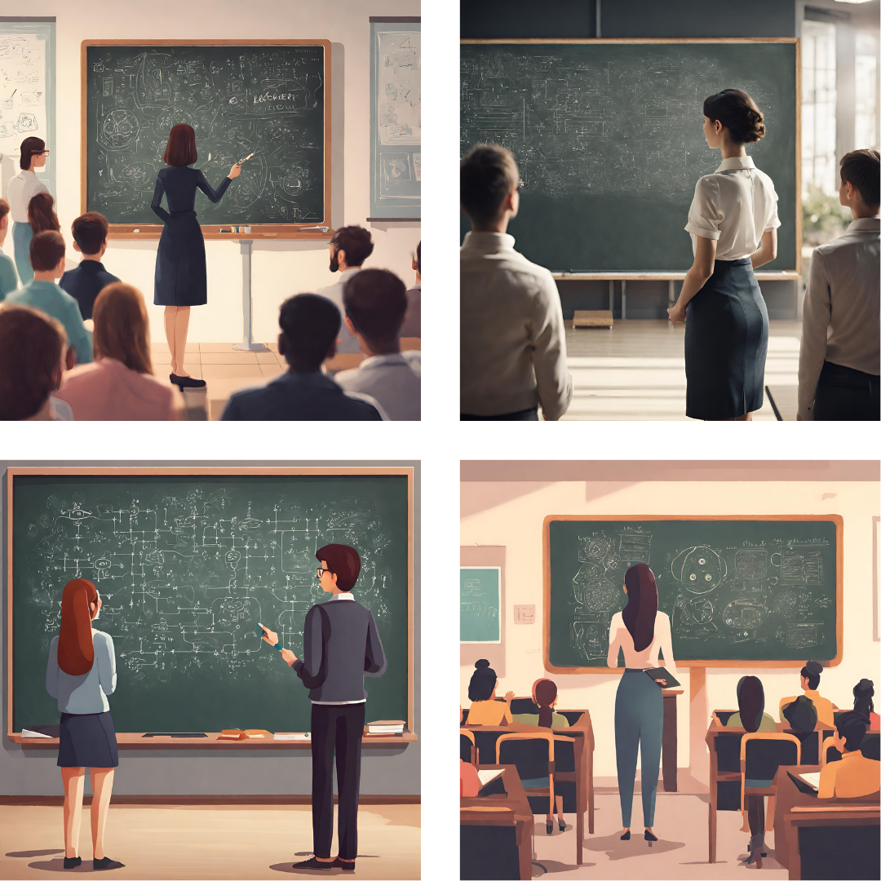
Creating Visuals, Audio and Video with AI
Canva - Magic Studio
Canva Magic Studio includes:
Magic Design
Magic Switch
Magic Media
Magic Expand
Magic Grab
Magic Edit
Magic Animate
Magic Eraser
Background Remover
Magic Morph
Magic Write
All of Canva's AI generation tools, when used to create and customize designs, are appropriate for both personal and business use.
While some of the Magic Studio features are free to explore, to make the most of the whole suite of tools and to customize your designs fully, you need to have a Canva Pro or Canva Teams account.
These images are made by Canva.

Slide 27
Creating Visuals, Audio and Video with AI
Canva - Magic Media
AI-powered design tools that aim to make content creation more accessible to everyone, regardless of previous design experience. Canva describes Magic Studio as “the world’s most comprehensive AI-design platform” for organizations and individual users, providing a host of new tools for automating labor-intensive tasks like converting designs into other media formats or instantly editing images through generative AI.
Canva also can generate photos, logos, vector images and illustrations.
These images are made by Canva.

Slide 28
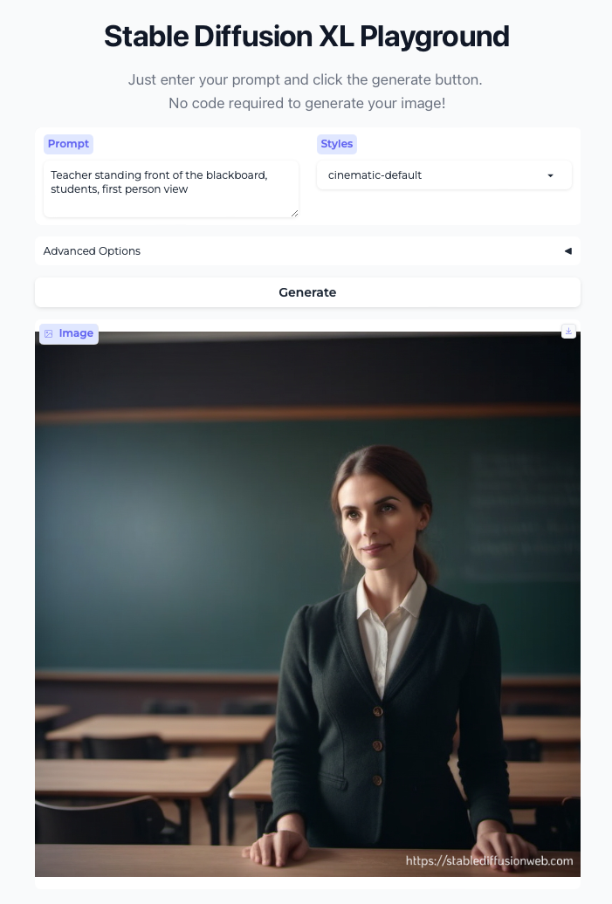
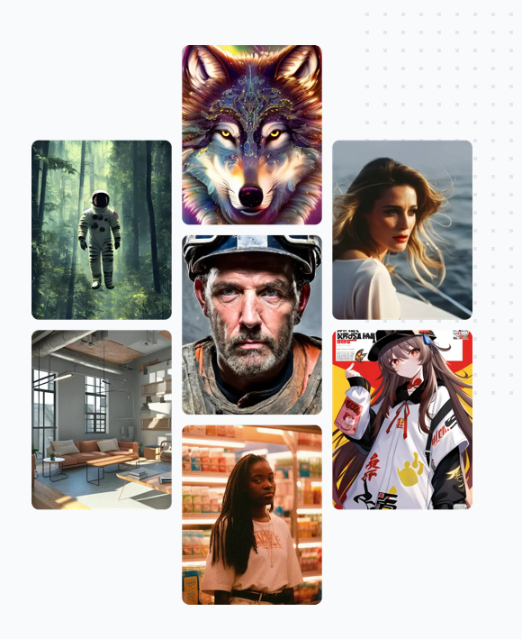
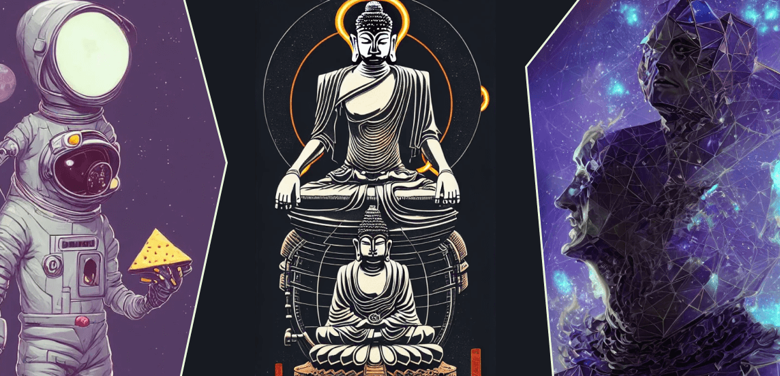
Creating Visuals, Audio and Video with AI
Stable Diffusion - https://stablediffusionweb.com
Stable Diffusion is an advanced deep-learning model that transforms textual descriptions into detailed images.
Stable Diffusion has prompts search engine. You can search AI generated images with the prompts used by everyone or AI artists.

Slide 29
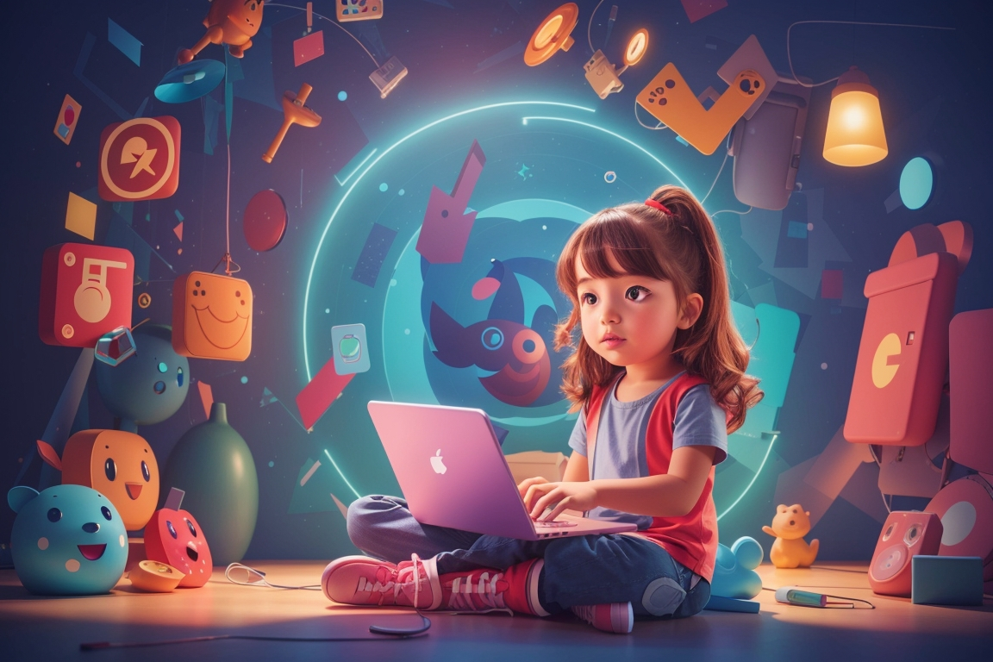
Creating Visuals, Audio and Video with AI
Leonardo.ai - https://leonardo.ai
Leonardo AI is a generative AI tool that specializes in creating visual assets such as textures, objects, and concept art. It is a platform that harnesses the power of artificial intelligence to create stunning and photorealistic images.
Leonardo offers a free tier that includes a daily quota of tokens (150 tokens). These can be used for your projects. This free offering doesn’t come with an expiry date.
You can search prompts from Community Feed and use in your generation.
These images are made by Leonardo.ai

Slide 30
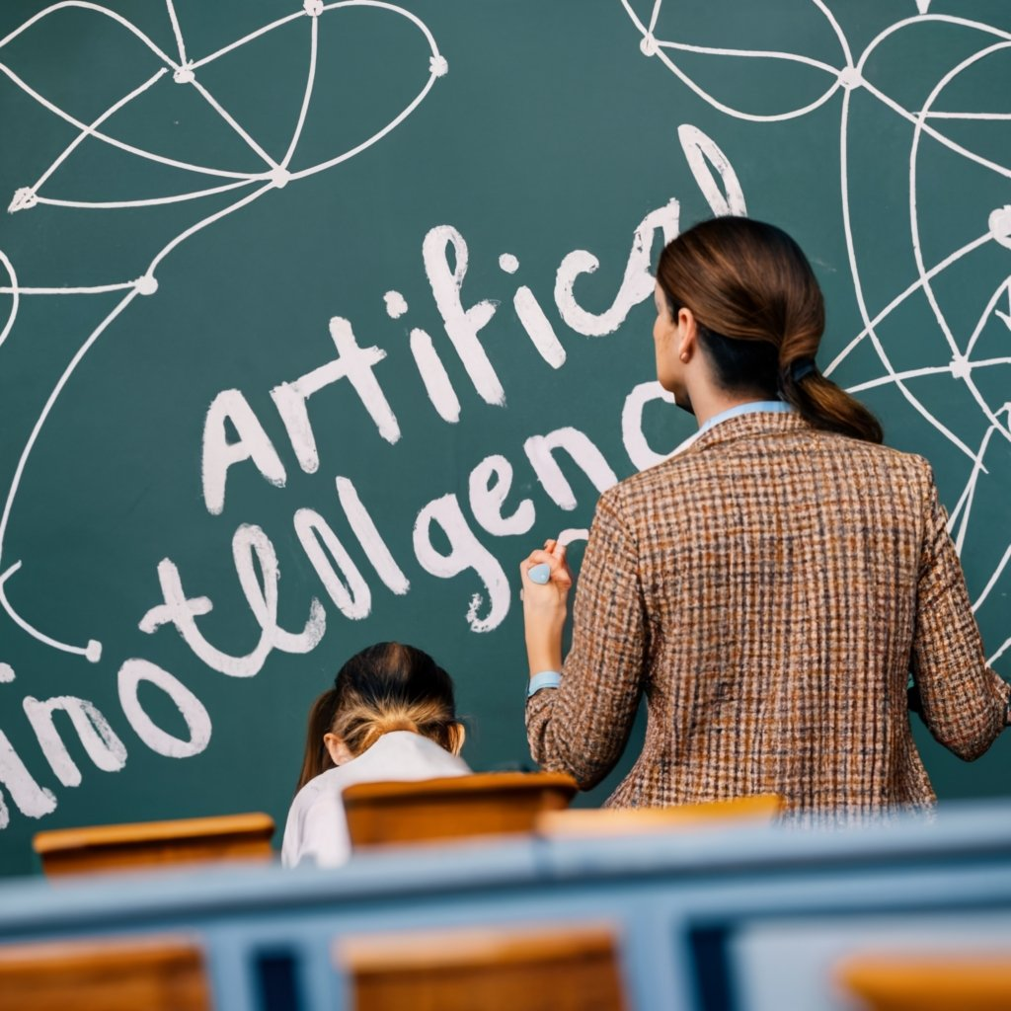
Creating Visuals, Audio and Video with AI
Ideogram.ai - https:/ideogram.ai
Ideogram is a free-to-use AI image generator that allows to generate images with text, and it even allows to create images of celebrities and mascots like Mario.
It can also remix generated images by applying a new visual style. A new style will be applied to the generated image.
Ideogram can generate logos, vector images and illustrations.
These images are made by Ideogram.ai

Slide 31
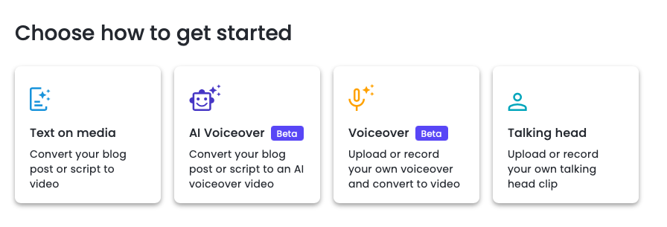
Creating Visuals, Audio and Video with AI
Lumen5 - https://lumen5.com
Lumen5 is an AI-powered tool that creates videos to accompany written content. Users can input a link to an article or blog post, or write some text, and Lumen5 will turn the text into a video. Users can then tinker with the video by adding music, inserting new photos, and tweaking the format. Lumen5 can be used in education to inspire student interest in a topic, support student learning with multimedia, and facilitate knowledge construction through the design of videos.
Lumen5 is free to use and videos can be exported with free plan (720p).
This video is made by Lumen5.

Slide 32
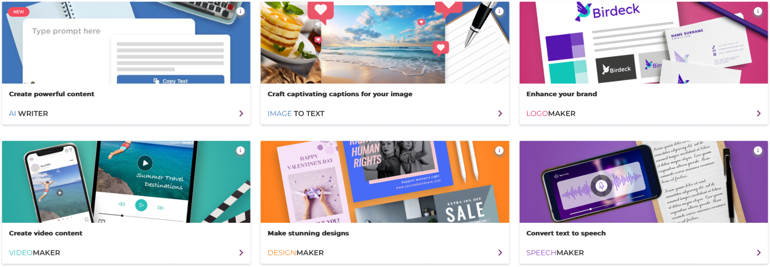
Creating Visuals, Audio and Video with AI
Designs.ai - https://designs.ai
Designs.ai is a highly automated online suite of graphic design tools. It can be used to create logos, videos, designs, graphics, convert text to speech, and lots more. It is particularly beginner-friendly.
Designs.ai is free to use and videos can be exported with free plan with watermark .
This video is made by designs.ai.

Slide 33
Creating a Complete Course Using the Created Content and Visuals
In this final stage of the educational material development process, the focus shifts towards integrating the accumulated content and visuals into a cohesive and comprehensive course module. Leveraging the previously generated content and visuals created using AI tools, the goal is to construct an engaging and informative learning experience.
During the development of the complete course module, it is imperative to pay attention to several key aspects:
Ensure alignment with the organizational objectives.
Maintain coherence and consistency between content and visuals.
Foster active participation through interactive elements.
Provide personalization to accommodate different learning styles and preferences.
Offer user-friendly interfaces and intuitive navigation.
Measure student comprehension and knowledge retention through effective assessments.
Deliver a comprehensive narrative to provide students with a well-rounded learning experience.

Slide 34
AI Tools Directories and Web Sites
AI Educator Tools: https://aieducator.tools/
There's An AI For That (TAAFT): https://theresanaiforthat.com/
Future Tools: https://www.futuretools.io/
AI Tools Directory: https://aitoolsdirectory.com/
Canopy Directory: https://www.canopydirectory.com/

Slide 35
THANKS
Questions?
METU Distance Education Application and Research Center
odtuzem@metu.edu.tr

